Slide 1
Blood Demand Prediction
By Rajil Jain (That Wise Advice)

Slide 2
Agenda
Objective & Scope
Data overview
Methodology
Results & Recommendations
Next Steps

Slide 3
Objective & Scope
Objective : Predict demand of various blood components across blood types for a blood bank / hospital
Scope : Predict demand on a weekly basis, assuming a hospital/blood bank estimates the weekly demand on a Monday

Slide 4
Key Observations & Recommendations
Data challenges such as missing header, inconsistent column names, missing request date, inconsistent date formats etc. eats up a lot of analysis time and makes the automation difficult.
Age & Gender distribution comes out to be a significant factor in determining the blood requirement

Slide 5
Methodology
We tried 2 ways to predict the demand of each blood component X blood group
Option 1 : (Prediction for blood component) X (% composition of each blood group)
Option 2 : Prediction for each unique blood component & blood group combination
A univariate time series approach (ARIMA/PROPHET) is not suitable as the seasonality in the data is not prominent. Therefore, we have used linear regression for time series prediction.

Slide 6
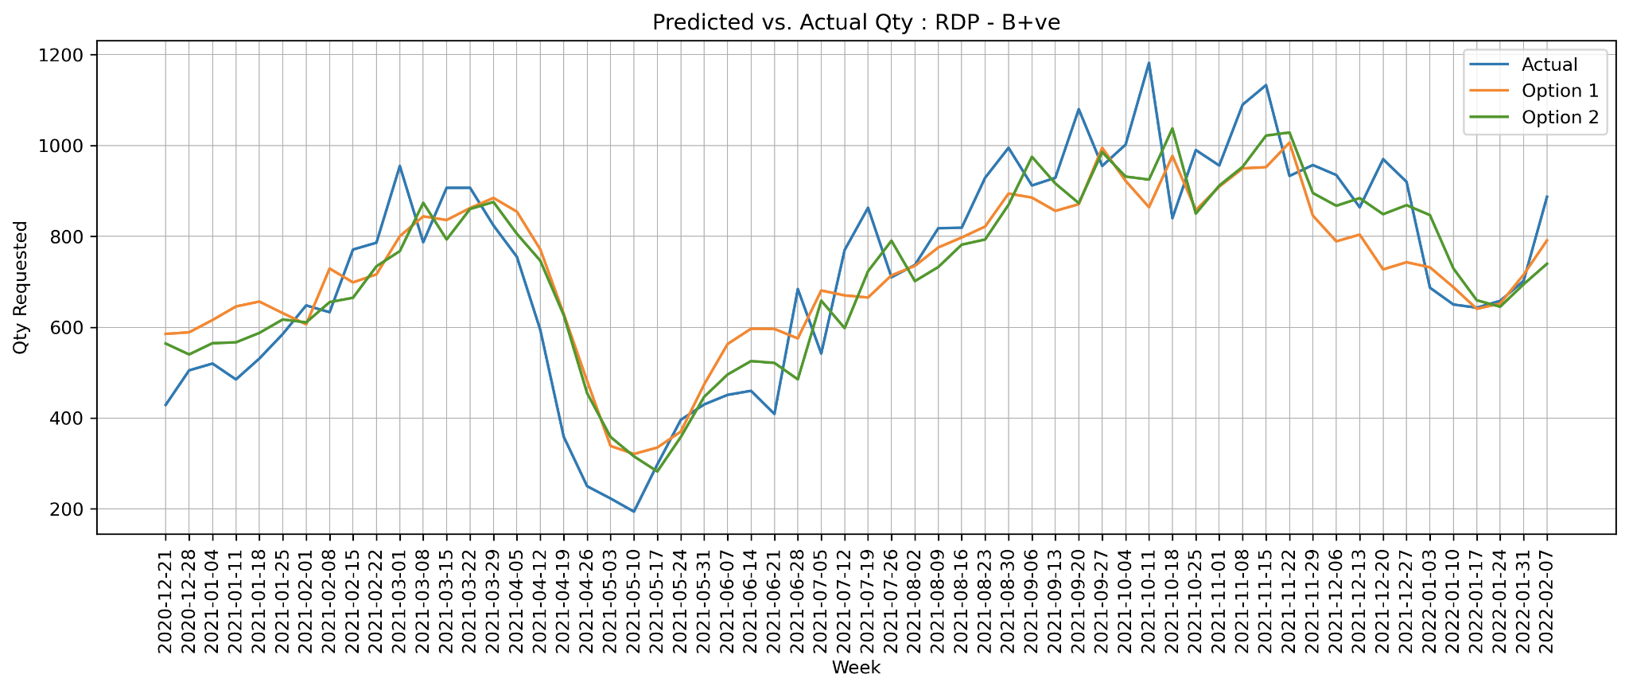
Results: Govt Hospital (RDP B+ve)
Option 2 gives better predictions than Option 1
(R-square 0.66 vs. 0.56)
We will use Option 2 for all predictions
*Similar results observed across blood component and group

Slide 7
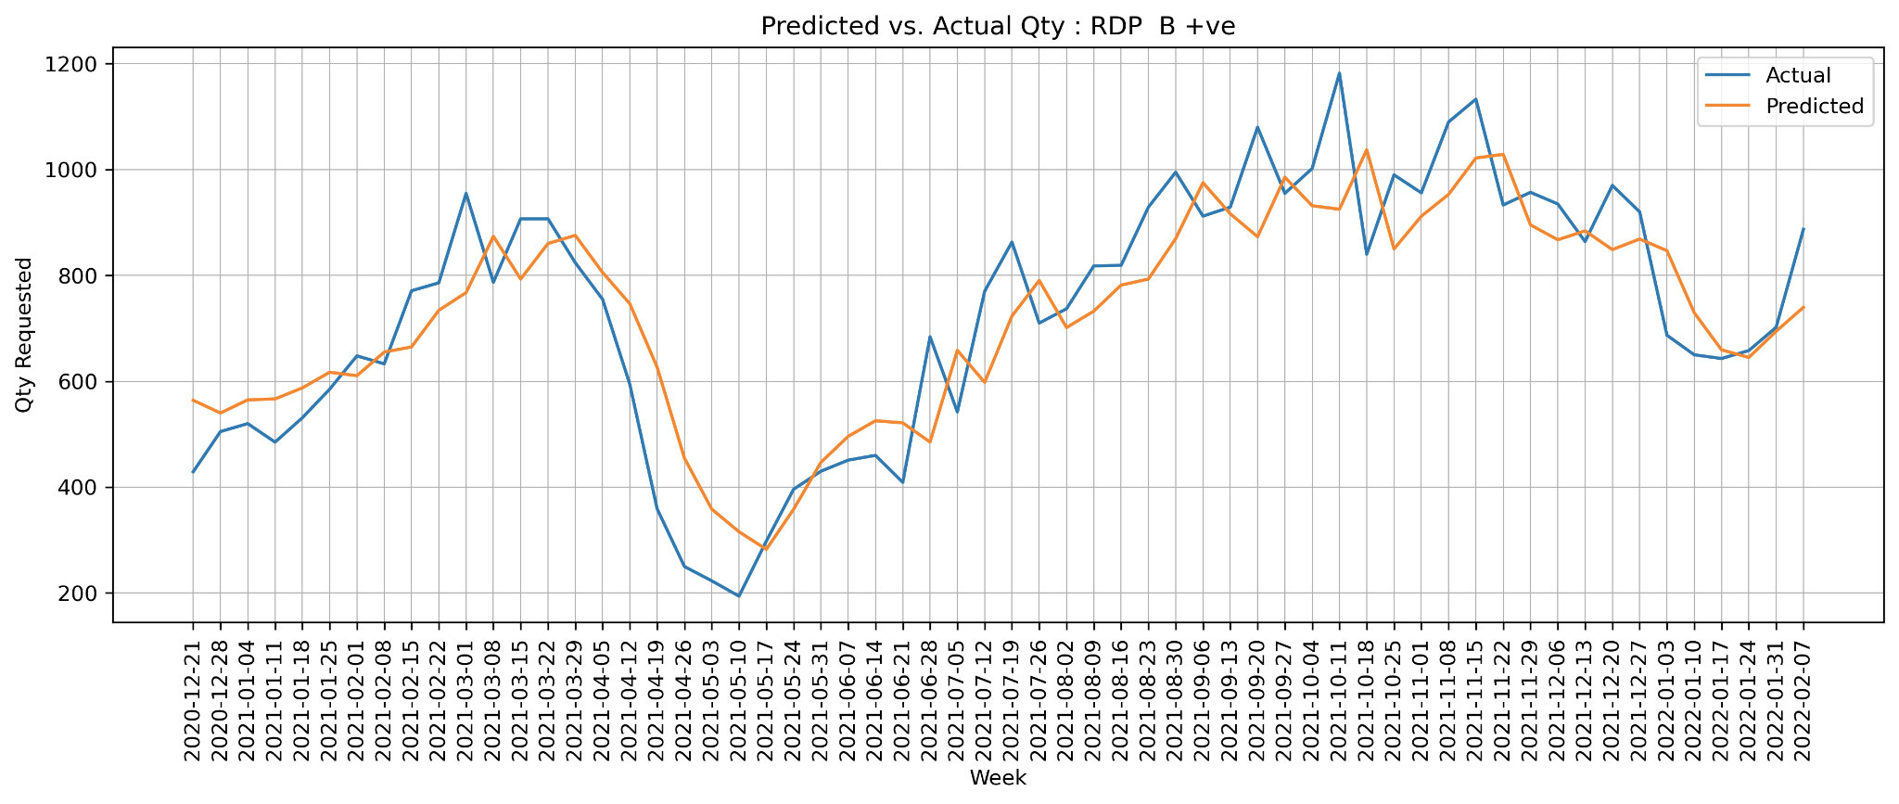
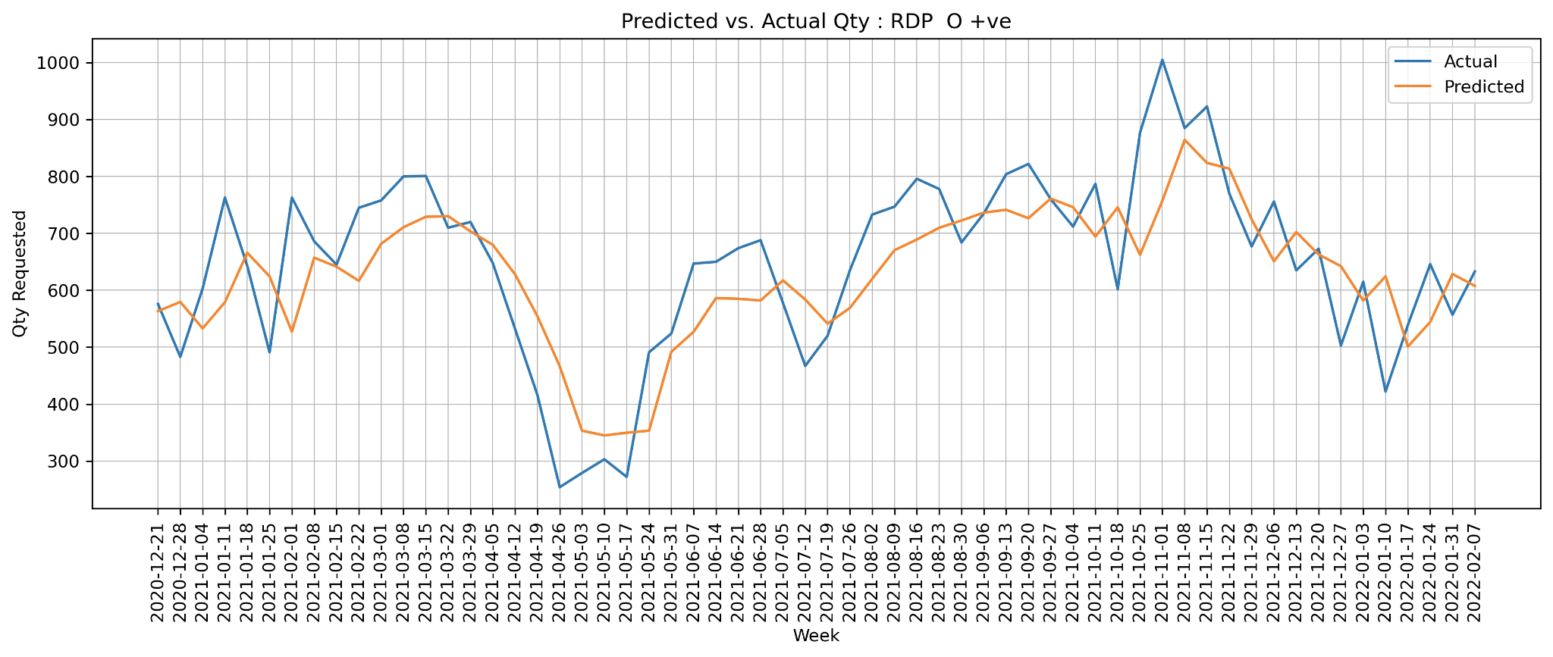
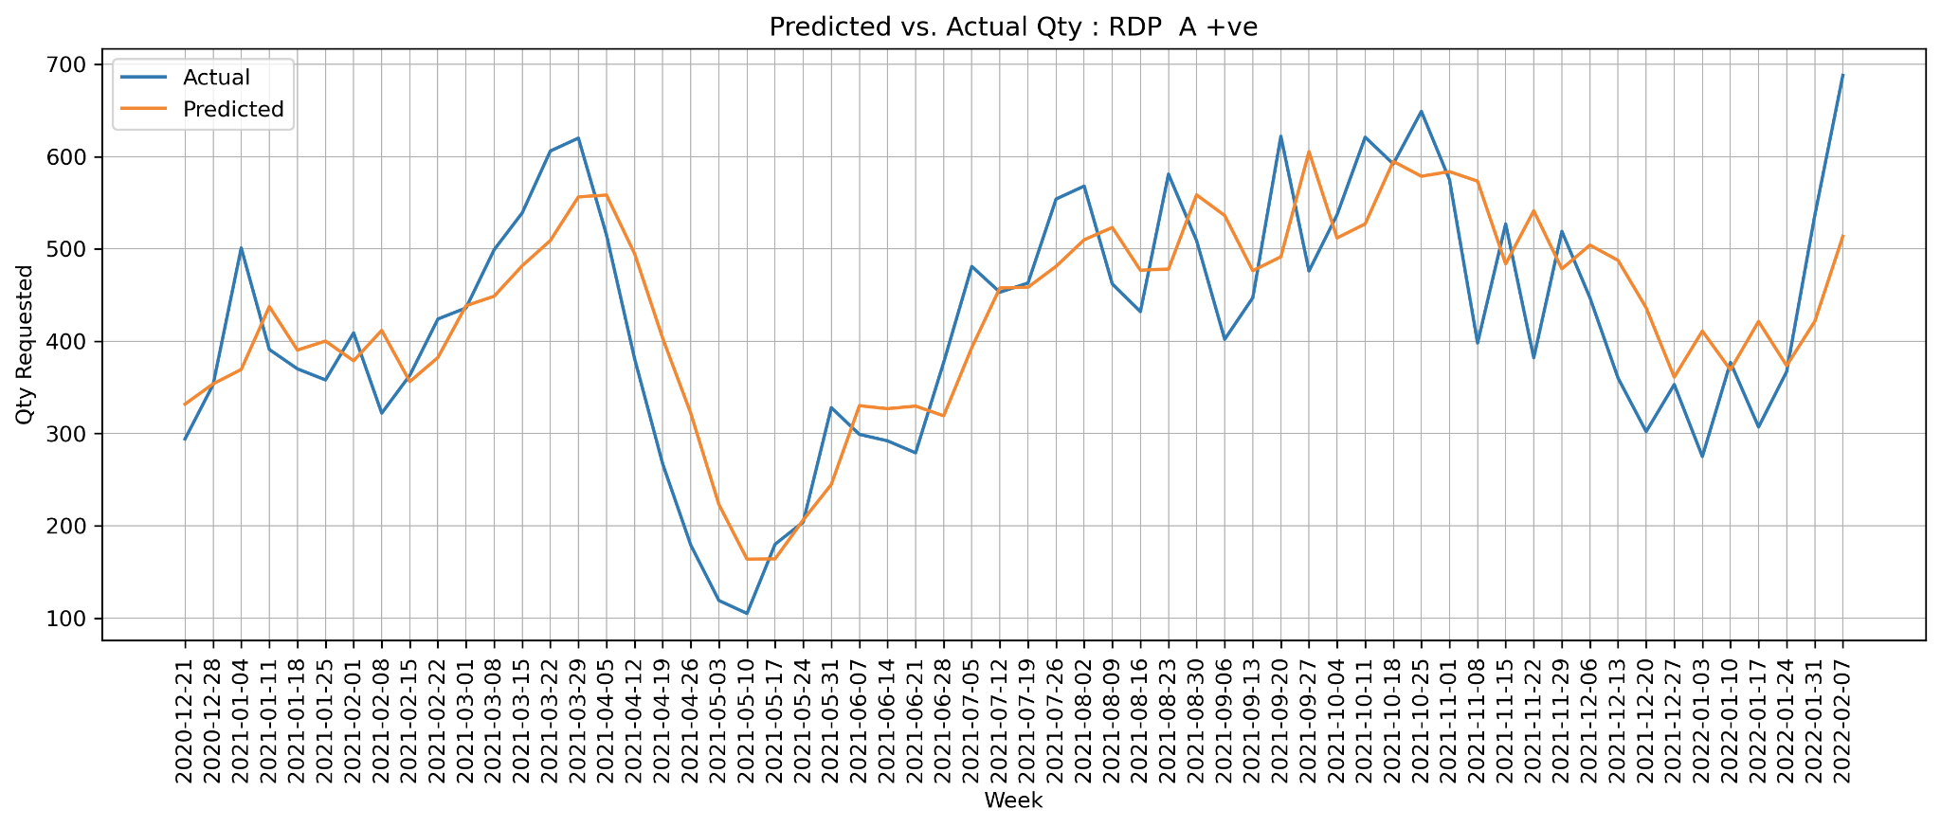
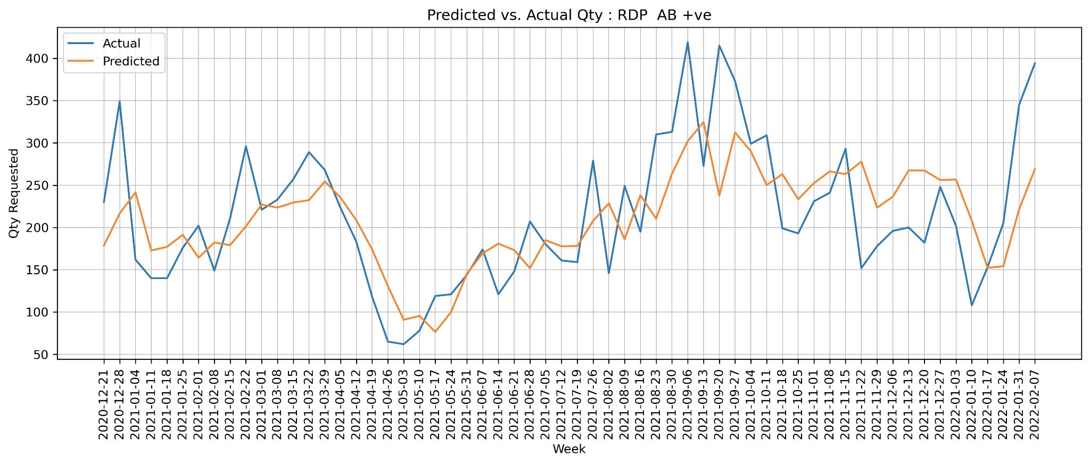
Results: RDP (Major Blood Groups)

Slide 8
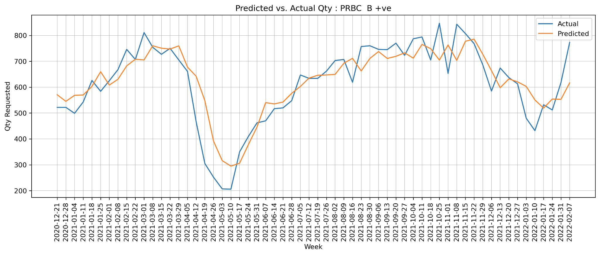
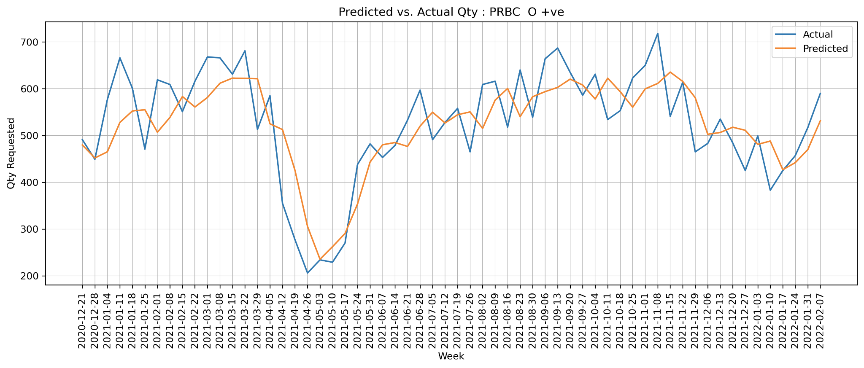
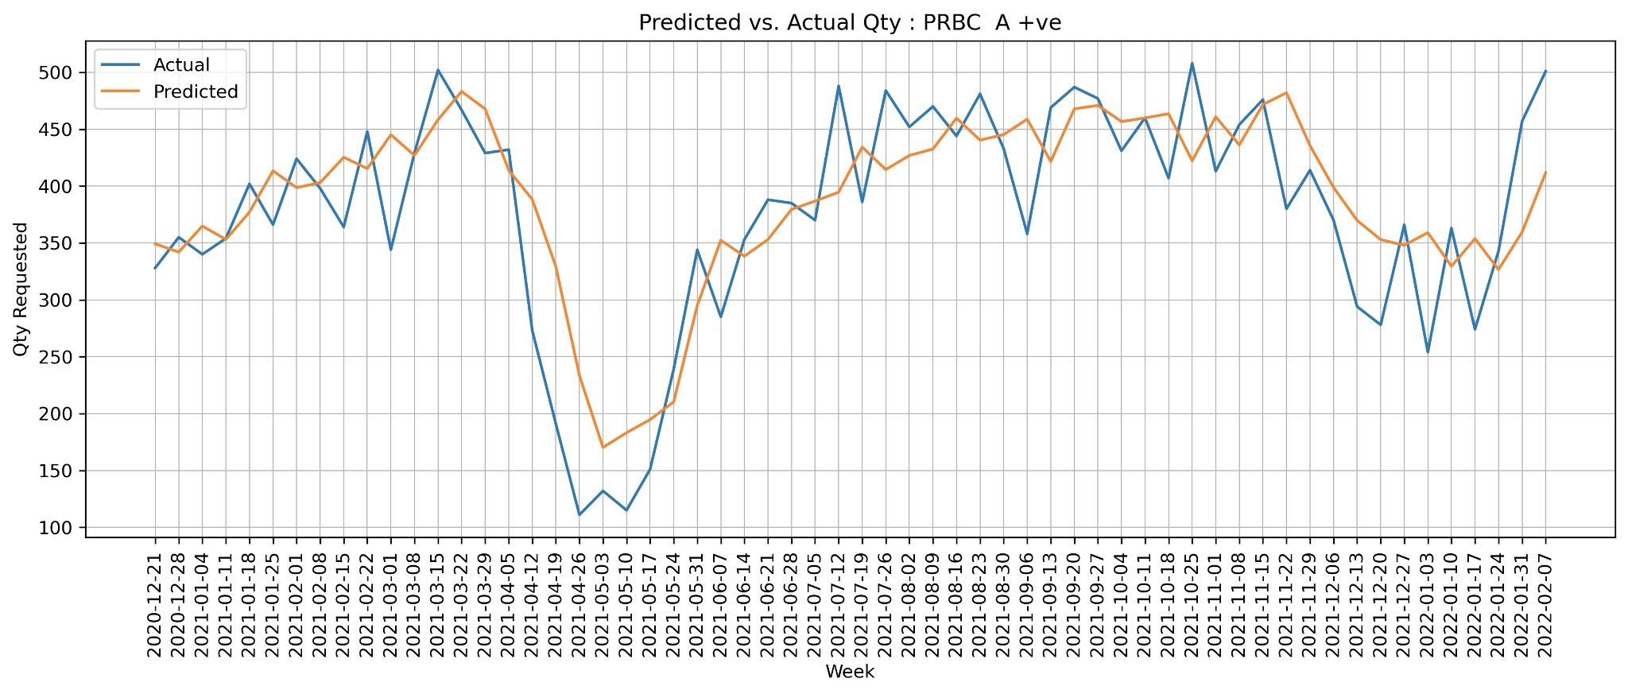
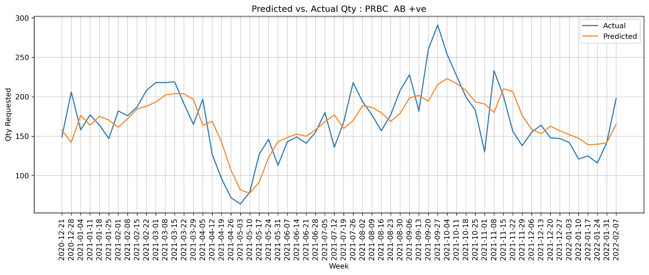
Results: PRBC (Major Blood Groups)

Slide 9
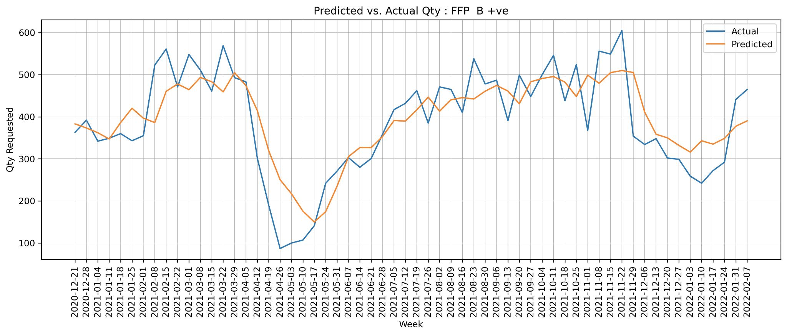
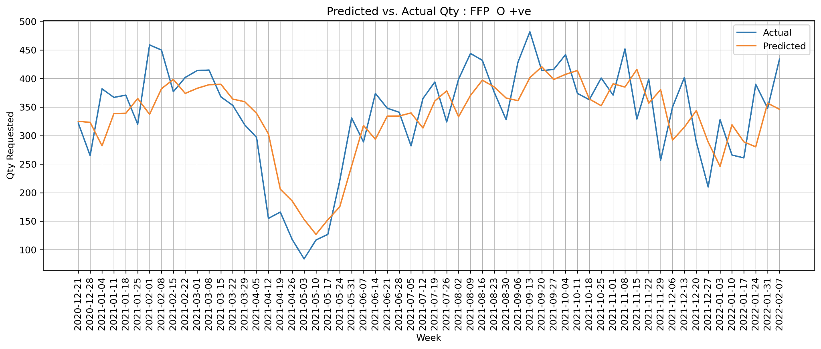
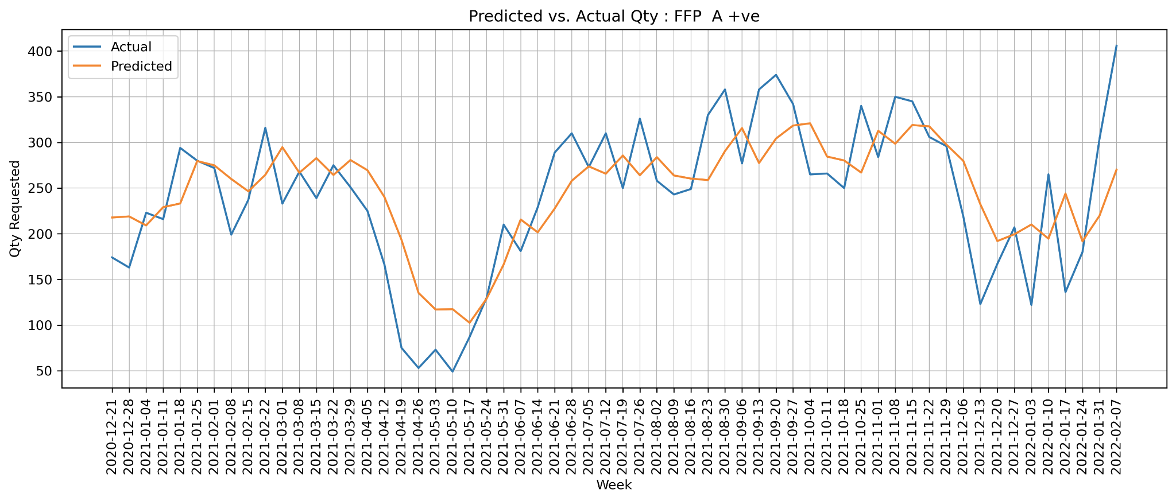
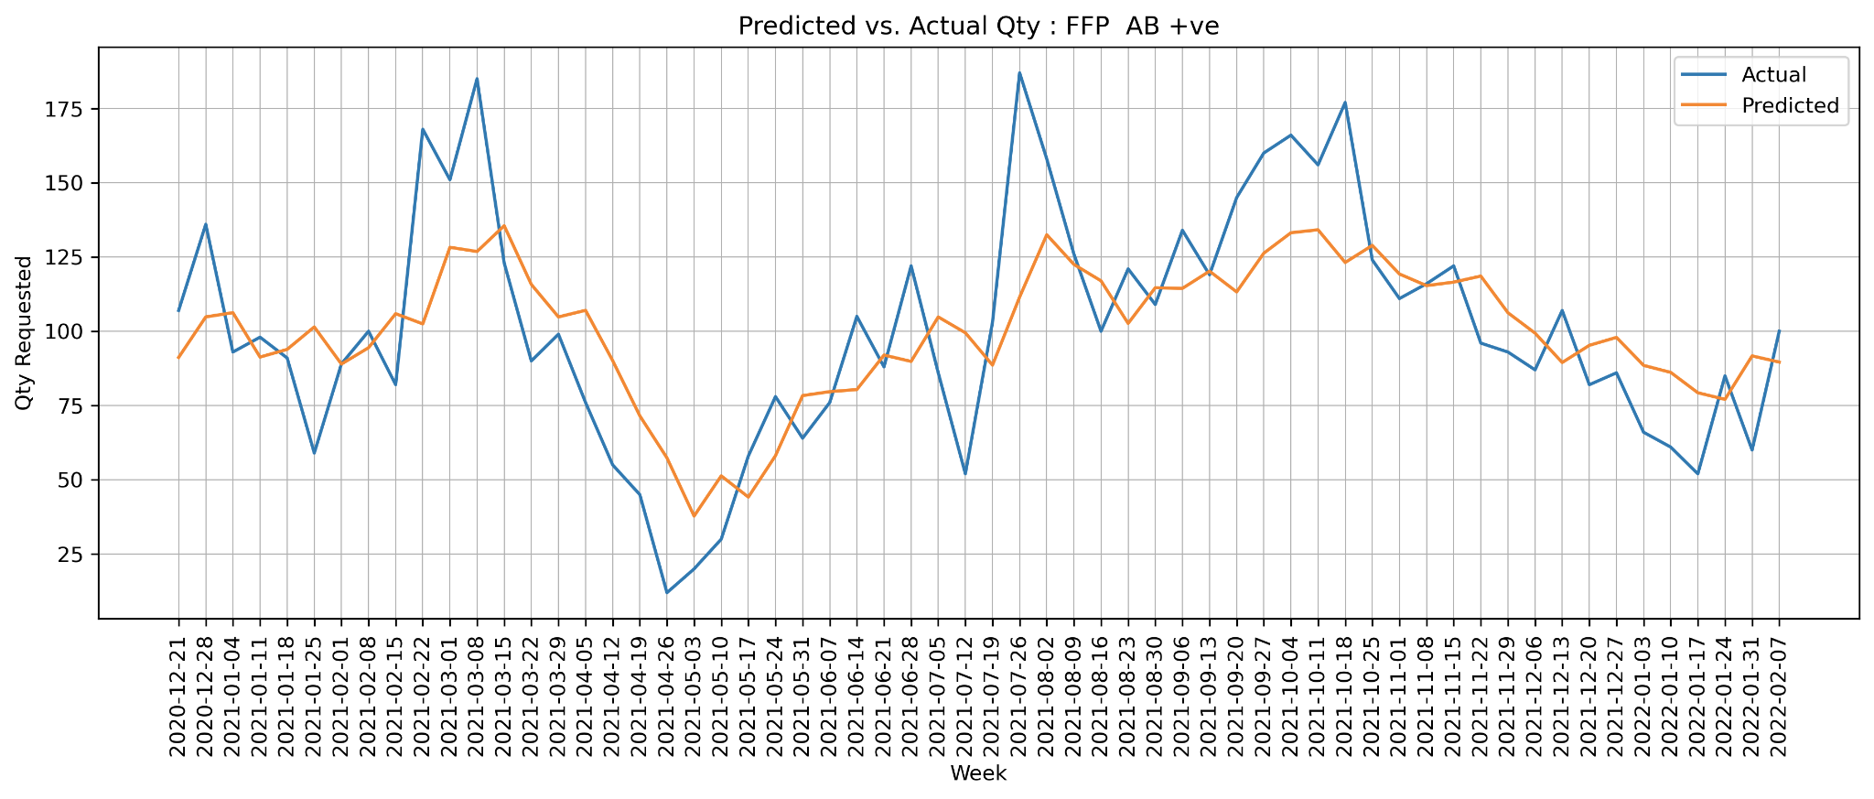
Results: FFP (Major Blood Groups)

Slide 10
Next Steps
Align the results with client and incorporate any feedback
Explore opportunity to add more features and further enhance model accuracy
Evaluate the model performance on other hospital data
Finalize the code and provide access to client

Slide 11
Appendix

Slide 12
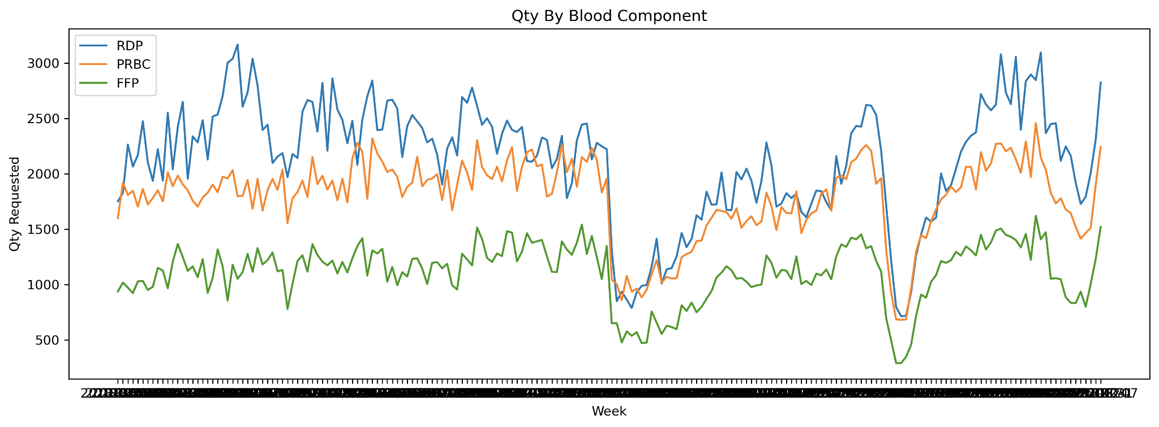
Blood Component Requirement By Time…(1)

Slide 13
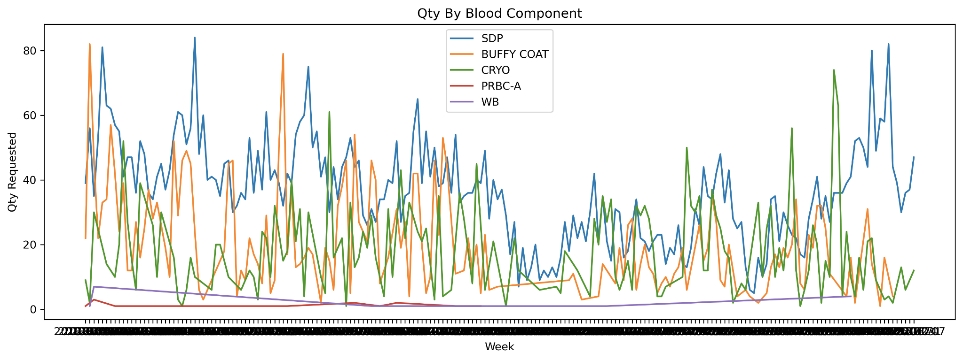
Blood Component Requirement By Time…(2)

Slide 14
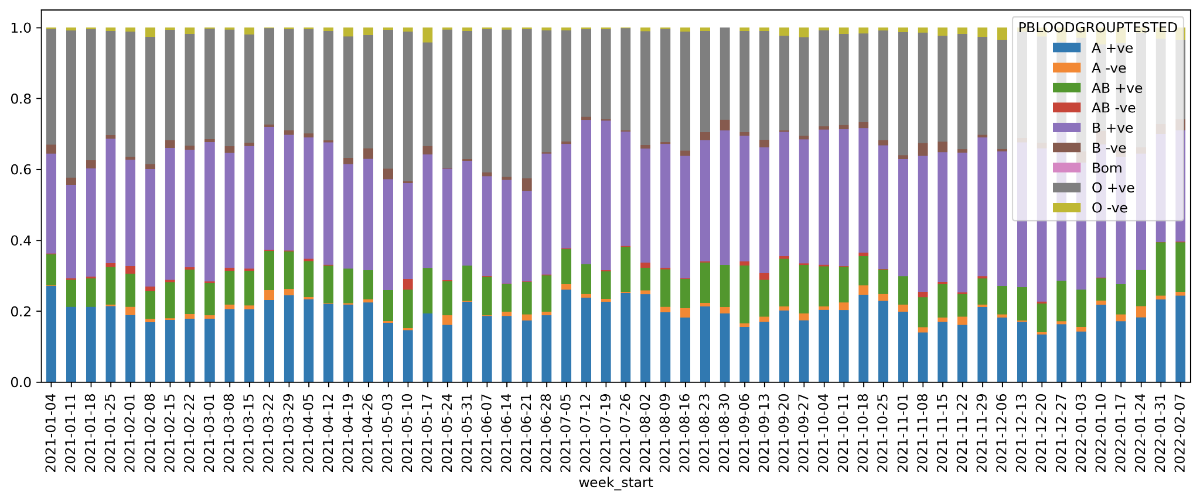
Blood Component Requirement [RDP]

Slide 15
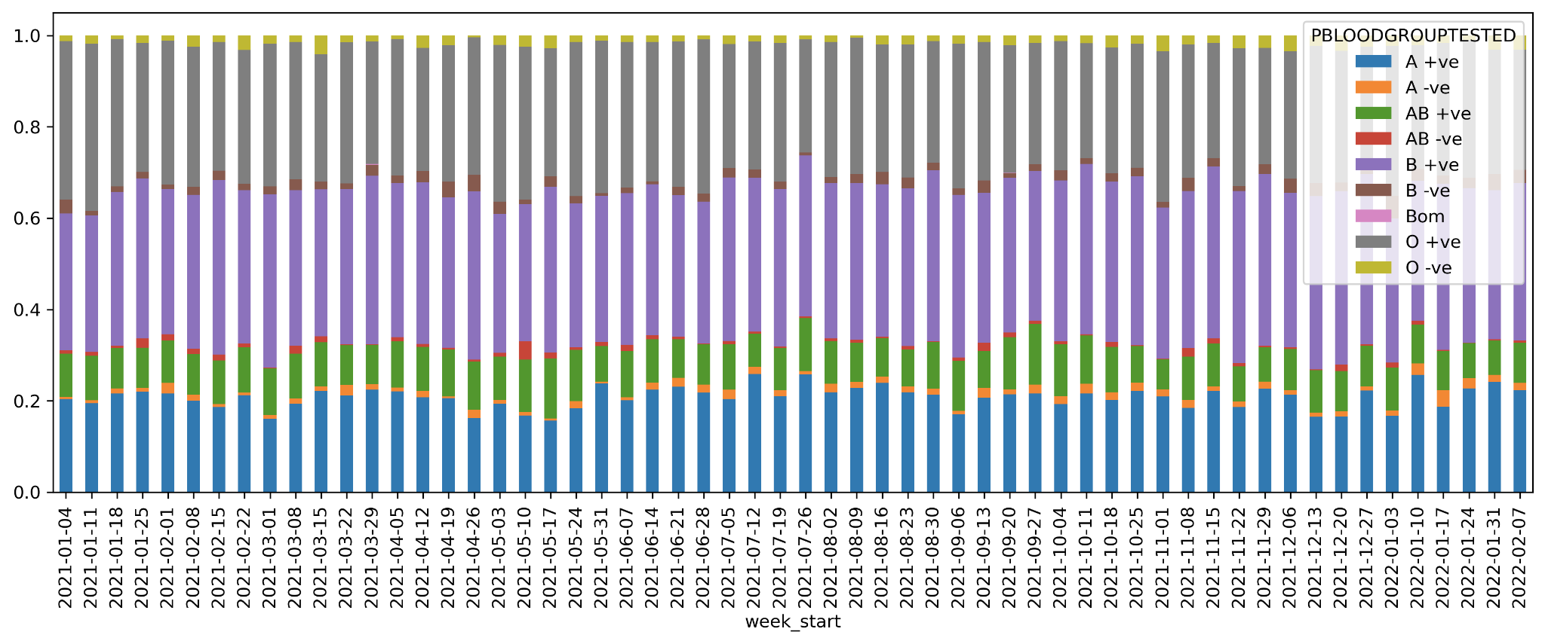
Blood Component Requirement [PRBC]

Slide 16
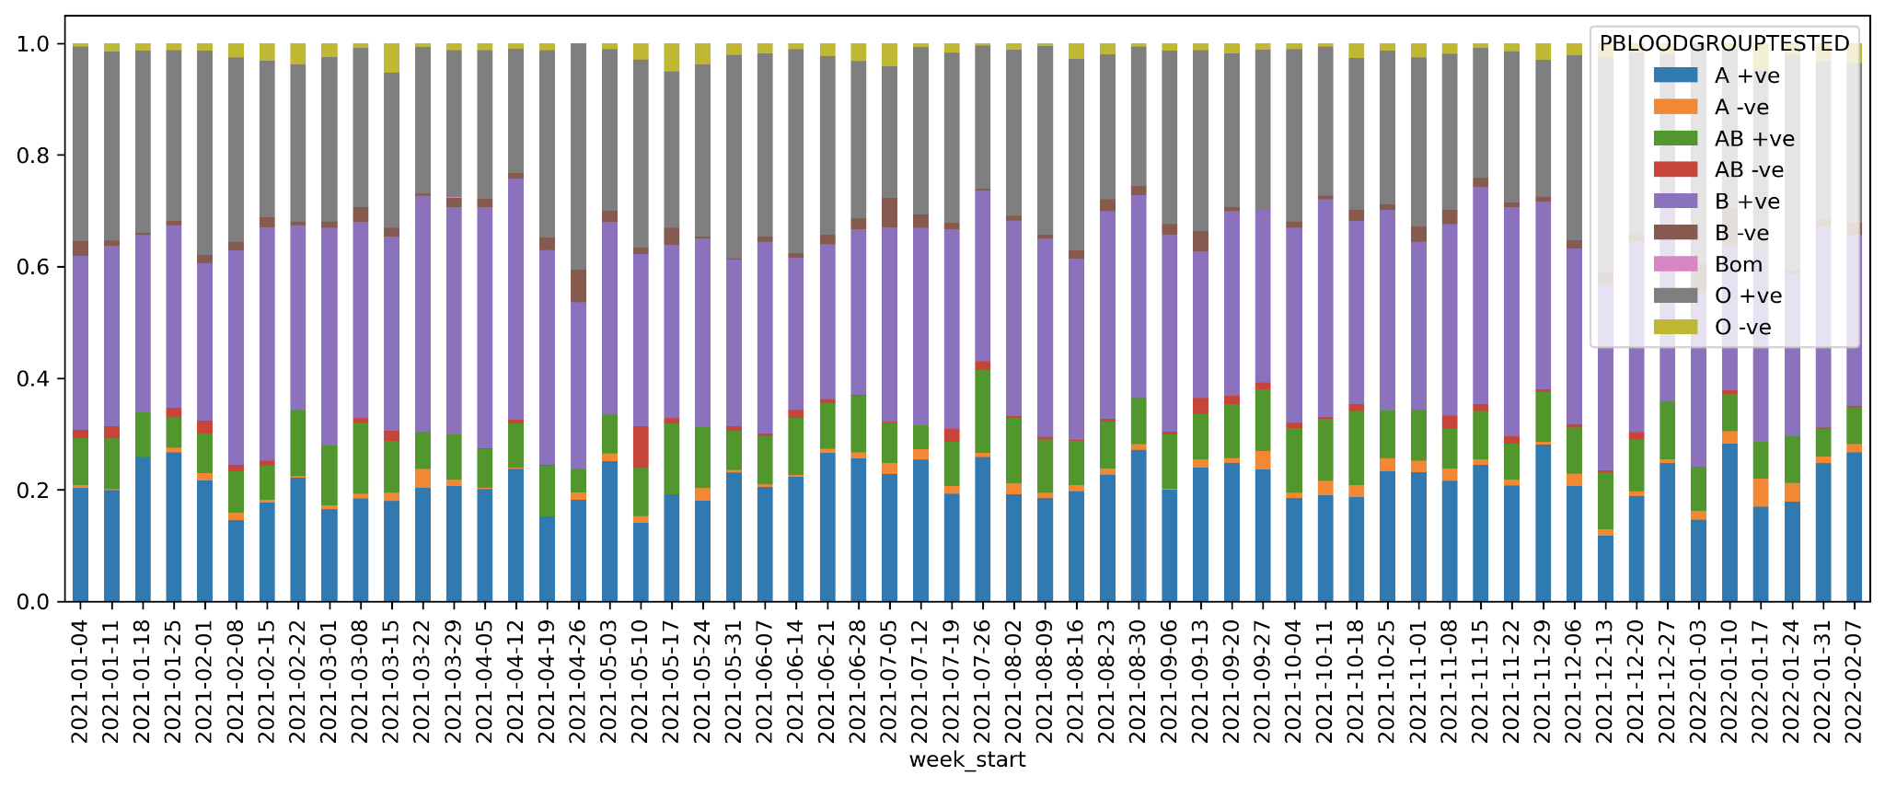
Blood Component Requirement [FFP]

Slide 17
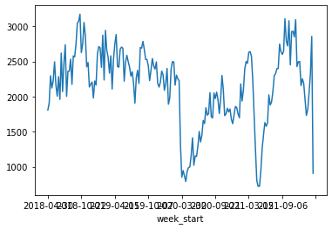
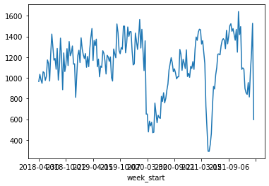
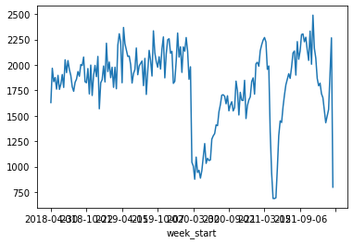
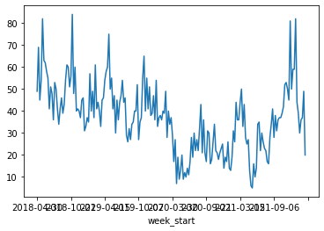
Blood Component Requirement By Time
RDP
FFP
PRBC
SDP

